Slide 1
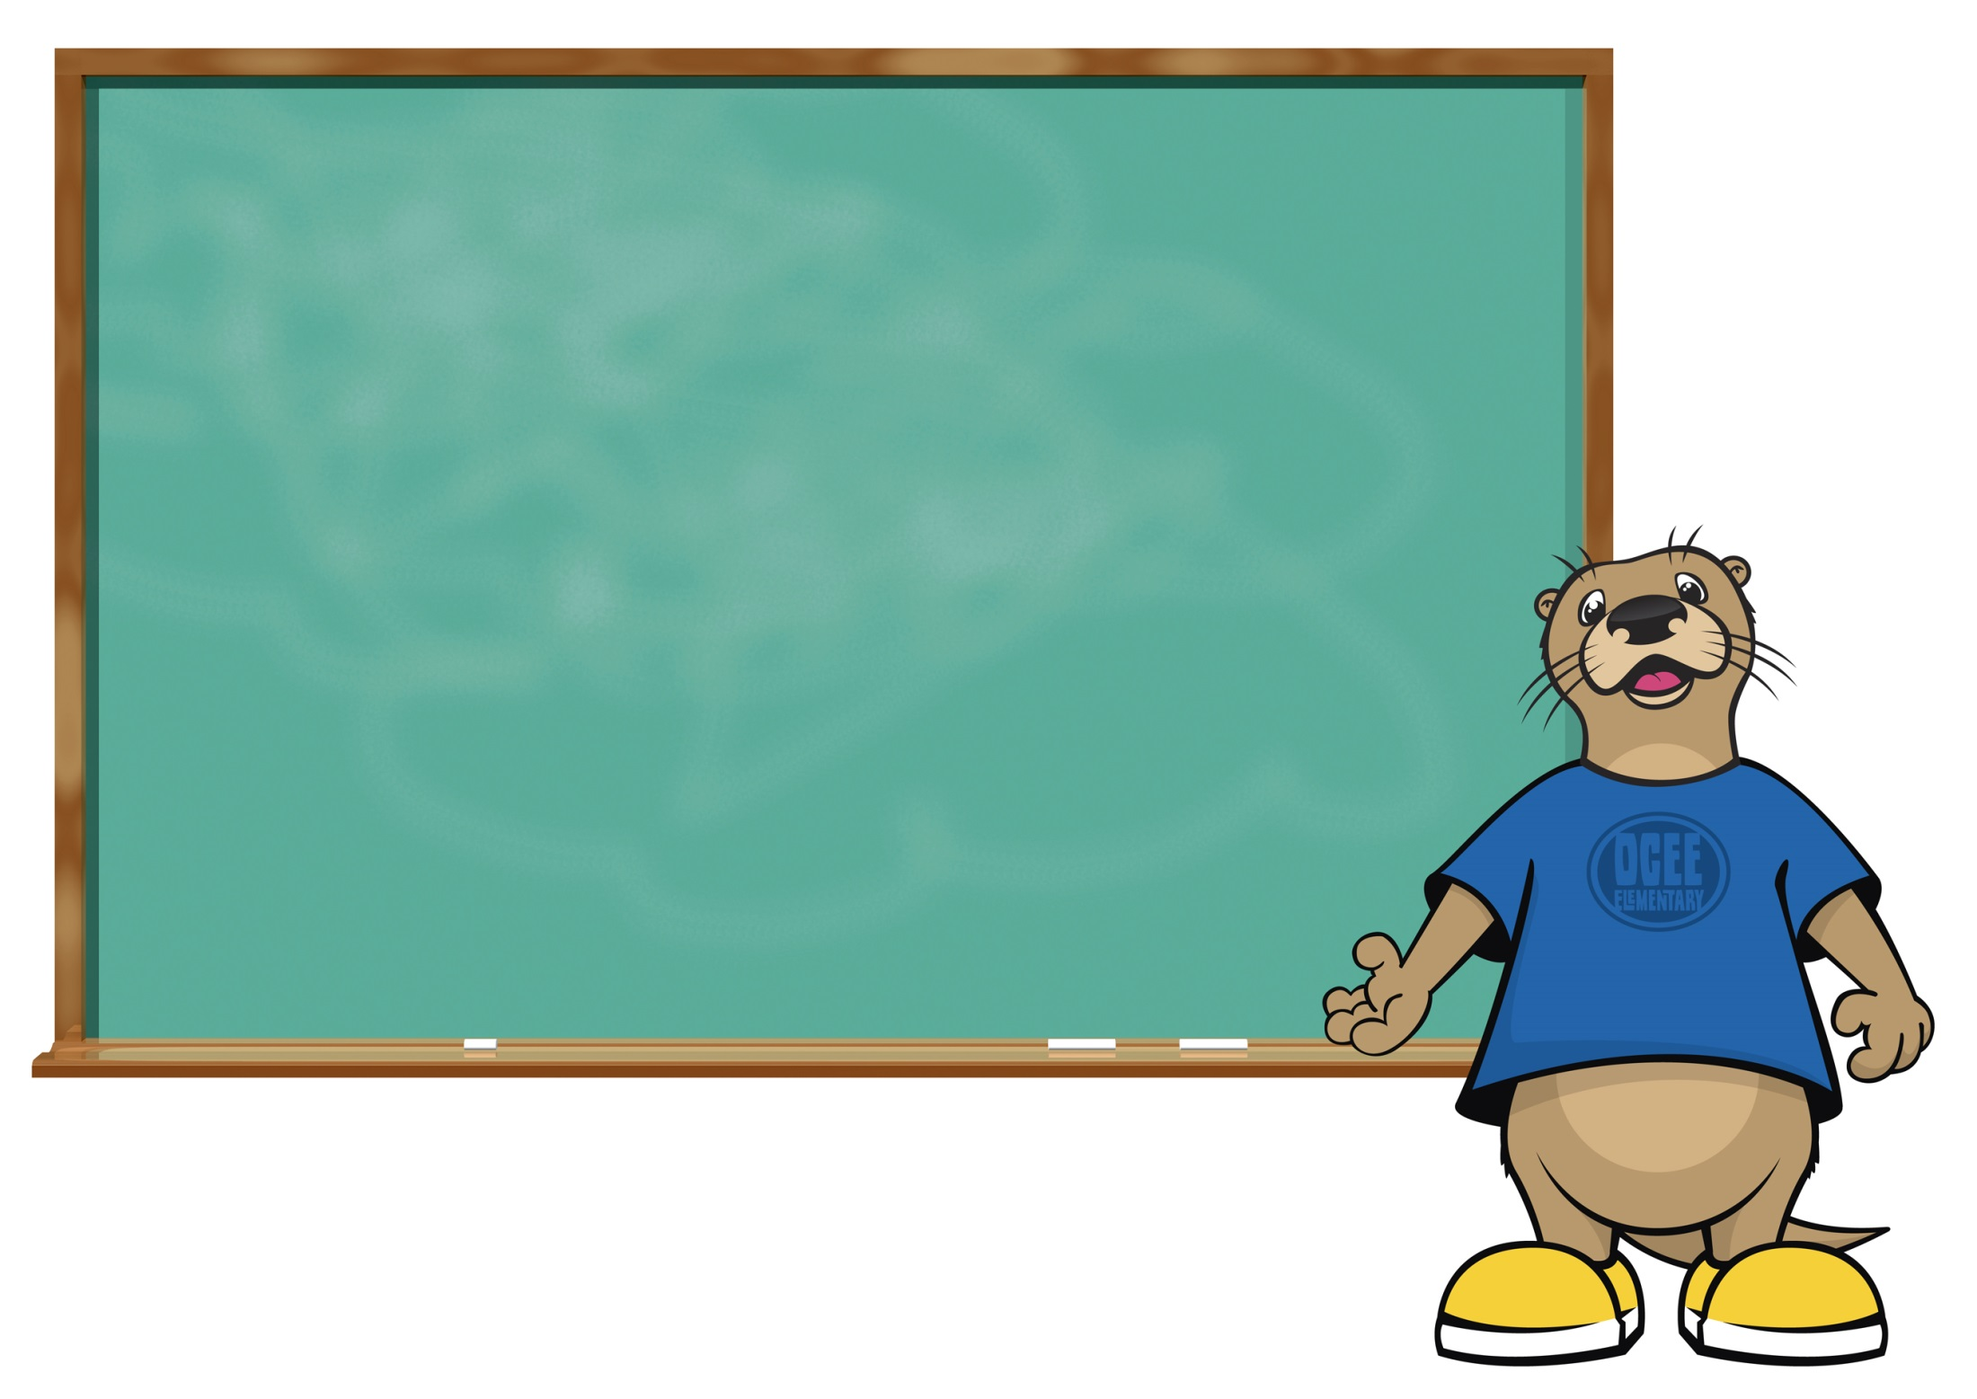
Math Matters
2nd and 3rd grades

Slide 2
“The teaching of mathematics has been viewed as a discrete set of rules and procedures to be implemented with speed and accuracy but without necessarily understanding the mathematical logic.
For some people, learning mathematics as procedures has been successful; but for the majority of our nation, knowledge of mathematical rules has not allowed them to use math confidently in their daily lives.
With almost 2/3 of the nation’s adult population fearful of mathematics, they have simply said “NO” to mathematics and closed the doors to careers that require higher math.”
(Parrish, 2010)

Slide 3
Unit | 2nd Grade | 3rd Grade
1 | Extending Base 10 Understanding | Numbers and Operations in Base Ten
2 | Becoming Fluent with Addition and Subtraction | Operations and Algebraic Thinking: the Relationship Between Multiplication and Division
3 | Understanding Measurement, Length, and Time | Operations and Algebraic Thinking: Patterns in Addition and Multiplication
4 | Applying Base Ten Understanding | Geometry
5 | Understanding Plane and Solid Figures | Representing and Comparing Fractions
6 | Developing Multiplication | Measurement

Slide 4
Accuracy: The ability to produce an accurate answer.
Efficiency: The ability to choose an appropriate, expedient strategy for a specific computation problem.
Flexibility: The ability to use number relationships with ease in computation.
Notes:
Fluency: Knowing how a number can be composed and decomposed and using that information to be flexible and efficient with solving problems.

Slide 5
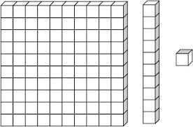
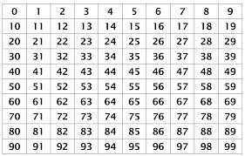
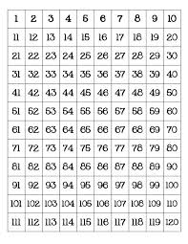
Ten Frames:
Base 10 blocks:
99 chart:
120 chart:
Notes:
Mathematical tools
Ten frames
Base 10 blocks
99 chart
120 chart
Number lines

Slide 6
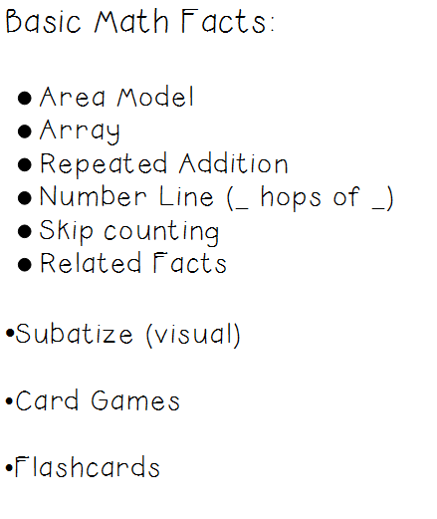

Slide 7
Types of addition and subtraction problems:
Result Unknown:
I have 8 apples and 3 bananas. How many pieces of fruit do I have in all?
8 + 3 = ?
Change Unknown:
I have 8 apples and some bananas. I have 11 pieces of fruit in all. How many bananas do I have?
8 + ? = 11
Start Unknown:
There are some apples in a bowl. Then I get 3 bananas. I now have 11 pieces of fruit. How many apples did I begin with? ? + 3 = 11

Slide 8
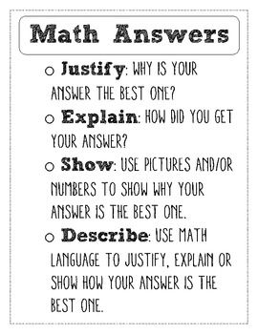

Slide 9
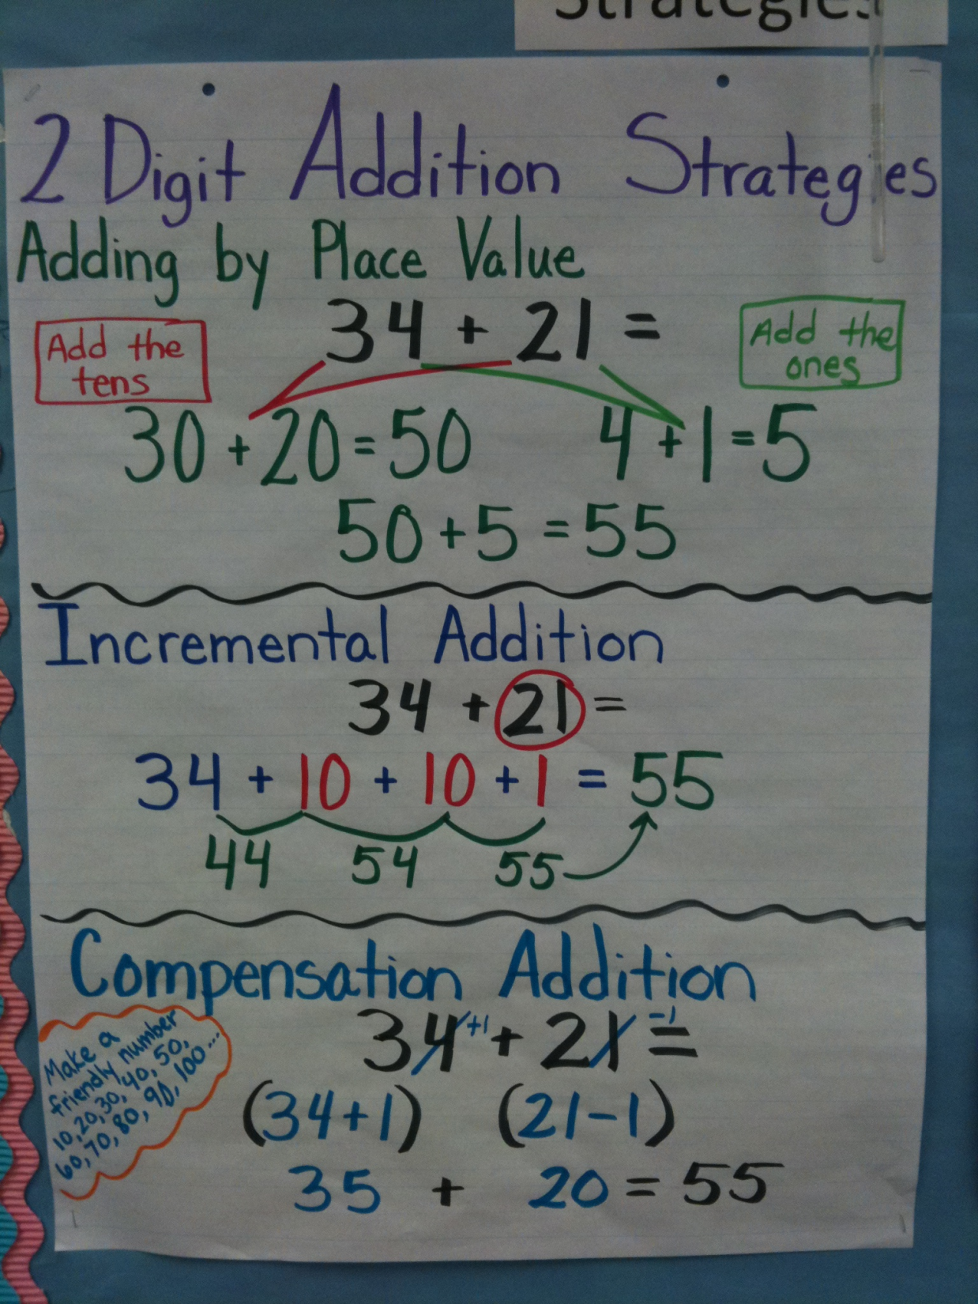

Slide 10
36 + 29 = ?
+ 10
+ 10
+1+1+1+1+1+1+1+1+1
36
46
56
65

Slide 11
Use the open number line to solve the following problems:
37+19
42+23
23+17
68+25
36+48

Slide 12
Focus on the Operations
Commutative property
If 6 + 4=10, then 4 + 6 = 10 – the order of the numbers does not matter.
Associative property
If 2 + 6 + 4 = 12, 2 + 10 = 12 – the sum of the addends stays the same regardless of the grouping of the addends.
Distributive property
If 8 + 5 = 13; 8 + 2 = 10 AND 10 + 3 = 13.
Zero property
Addition and subtraction are inverse operations (fact families)

Slide 13
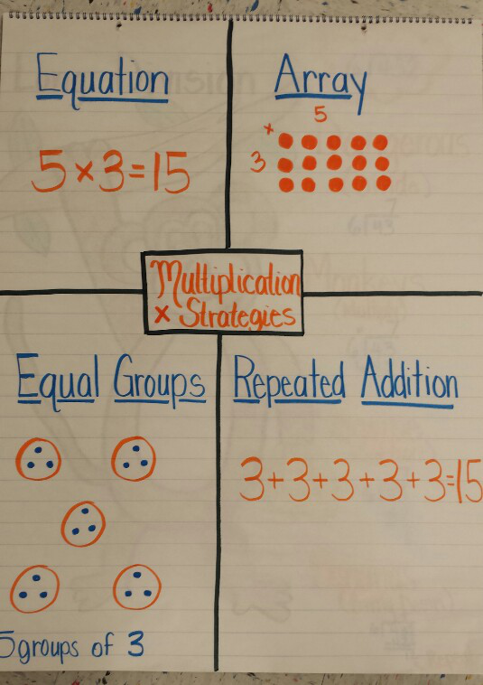

Slide 15
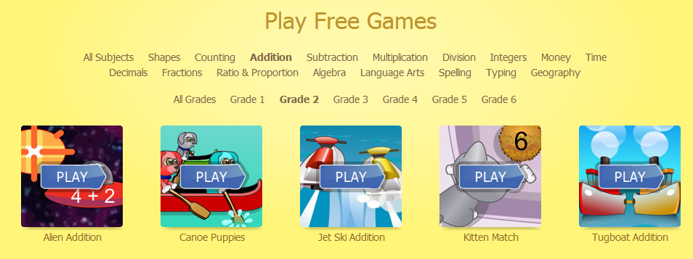
http://www.arcademics.com/

